Slide 1
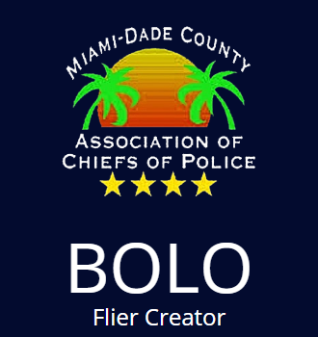
BOLO Flier Creator Version 6
Final Presentation
Fall 2016
Team Members: Brian Zamora, Dominick Martelly
Project Owners: Jason Cohen, Frank Jagger
Instructor: Masoud Sadjadi

Slide 2
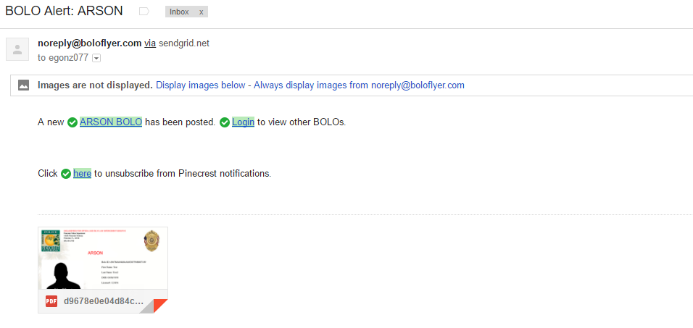
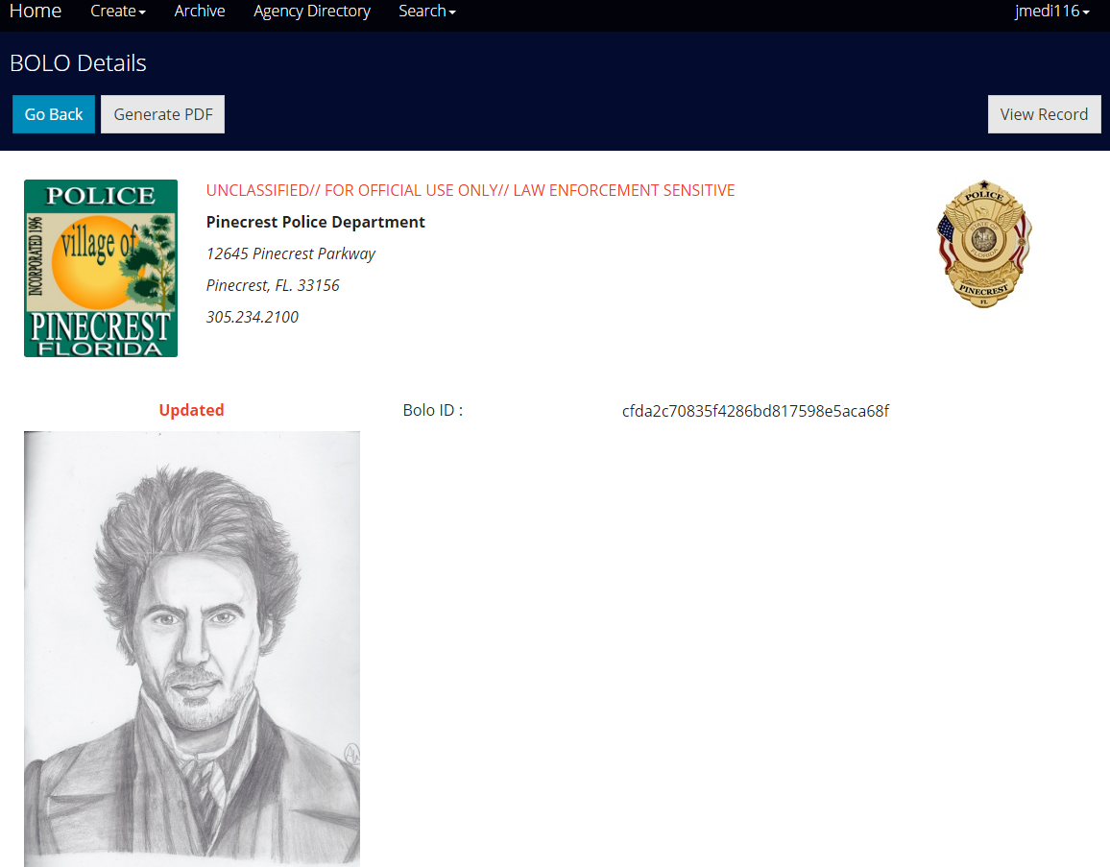
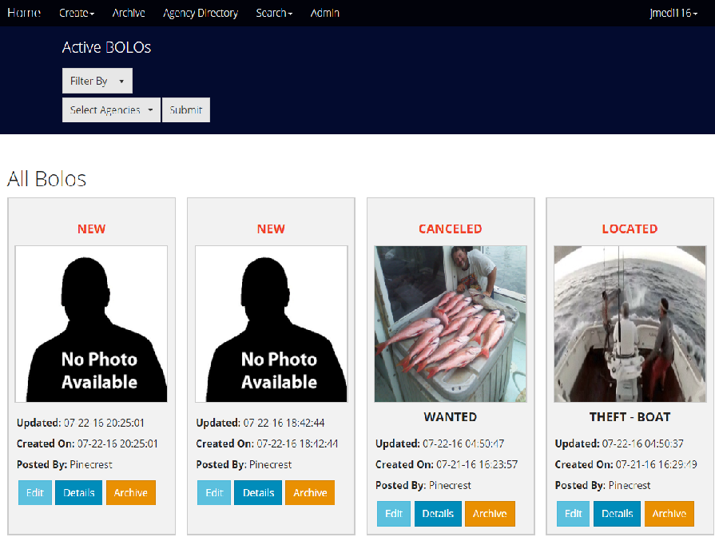
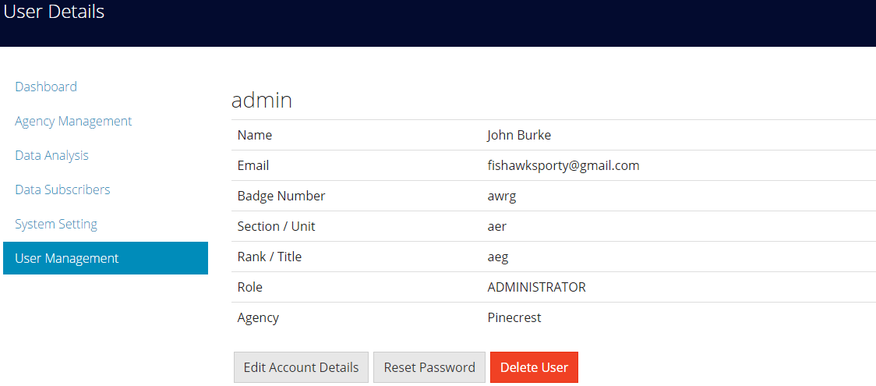
Project Definition

Slide 3
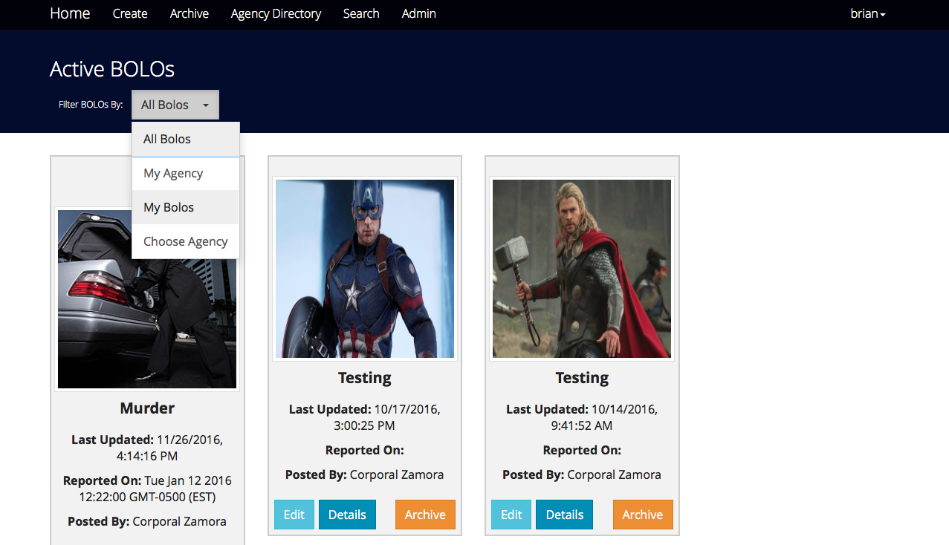

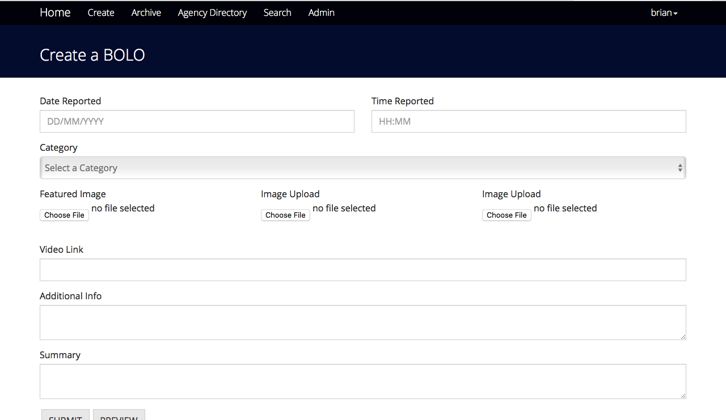
Project Definition

Slide 4
Requirements: Use Cases

Slide 5
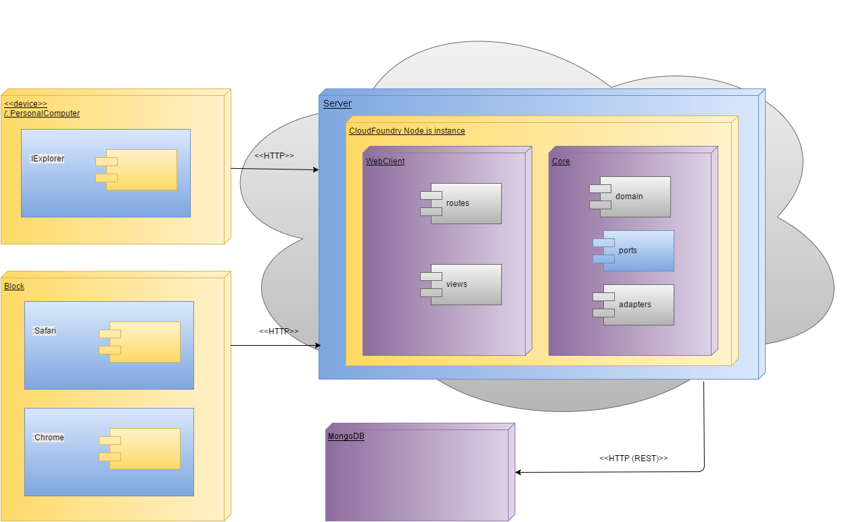
System Design: Architecture
BOLO 6.0 uses a Hexagonal architecture.
All features within the application are determined through routes which transfer the requests a service, which send the correct call to a repository, which is the entity allowed to read and write from the MongoDB database. The MongoDB was added in this version.
Hardware for server
Windows/Apple Computer
Min of 8Gb of RAM
At least 30 GB of disk space
At least 2.0 GHZ processor

Slide 6
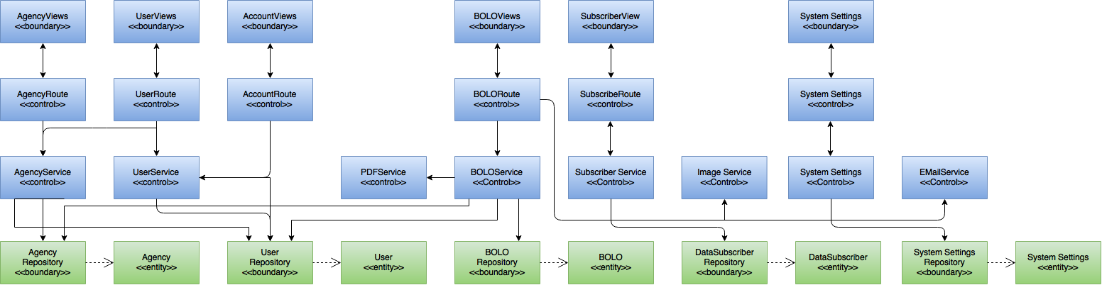
Minimal Class Diagram
Patterns Used
Observer: This is essential to maintain an organized execution of asynchronous calls in order to prevent the system from malfunctioning.
Singleton: Only one instance of the server will be allowed to run at a time
Repository: This abstraction is used to mediate between the domain and the persistent data storage so that if the database service was to be changed, it can be done without altering the entire code.

Slide 7
User Stories
#1188 – Convert Database to MongoDB
#1194 – BOLO Category Creation
#1179 – View All Pictures On Bolo Details Page
#1196 – BOLO Template Rendering
#1180 – Set Password
#1187 – Generate watermark on BOLOs
#1195 – Adjust CSV Uploading
#1199 – Adjust PDF Rendering for MongoDB

Slide 8
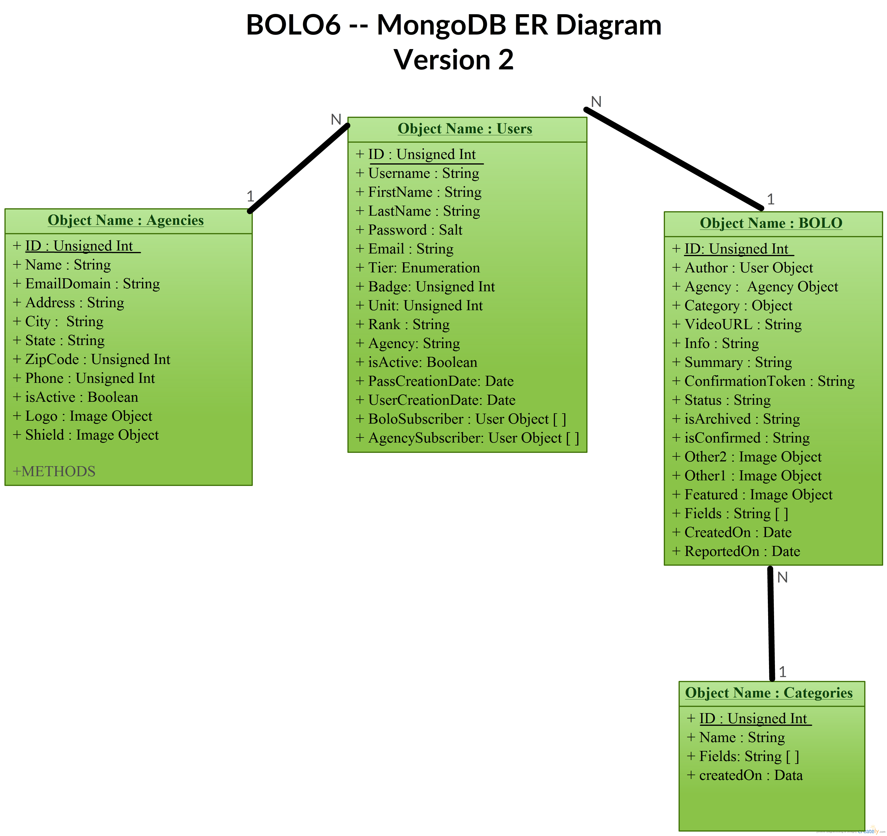


#1188 – Convert Database to MongoDB
Due to security policies being followed by the product owner, the BOLO web application had to be transitioned from Cloudant, an IBM proprietary NoSQL persistence platform), to MongoDB an open source NoSQL persistence platform.
This allowed for all of the data to be stored in the product owner's own servers.
Due to security policies being followed by the product owner, the BOLO web application had to be transitioned from Cloudant, an IBM proprietary NoSQL persistence platform), to MongoDB an open source NoSQL persistence platform.
This allowed for all of the data to be stored in the product owner's own servers.
Due to security policies being followed by the product owner, the BOLO web application had to be transitioned from Cloudant (an IBM proprietary NoSQL persistence,

Slide 9
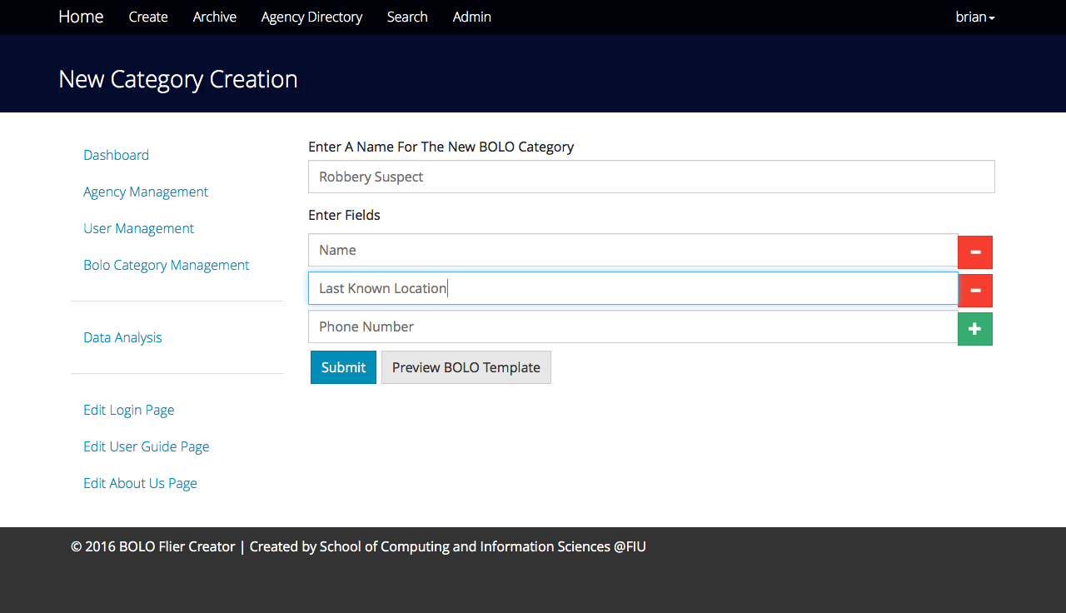
#1194 – BOLO Category Creation
The added functionality, allows a root or administrator of the BOLO system to be able to create their own BOLO Category that other users can use.
In previous versions, the user was limited to only being able to create a General Bolo, an Auto Theft Bolo, and a Boat Theft Bolo.

Slide 10
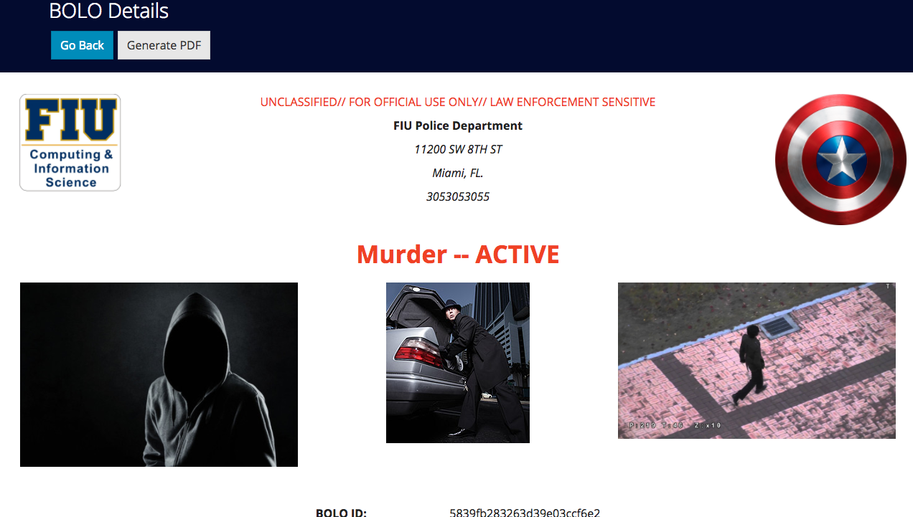
#1179 – View All Pictures On Bolo Details Page
This added functionality, allows a user to view all pictures that a Bolo flier has.
In previous versions, the user was only able to see the featured image even if more pictures were also uploaded.

Slide 11
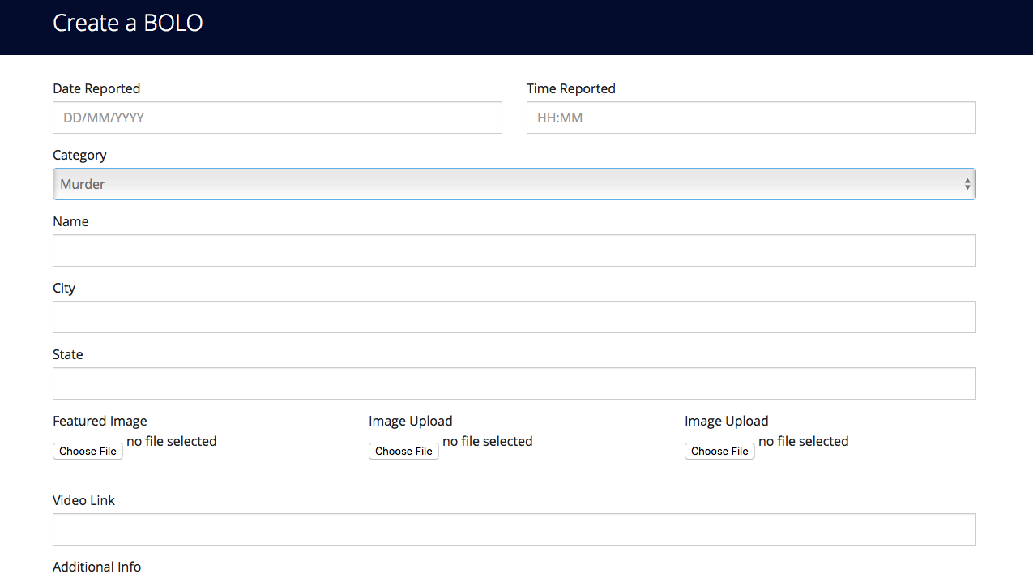
#1196 – BOLO Template Rendering
This added functionality, allows a user to render the fields of any category from a single page. This allows to create any type of Bolo from one page.
In previous versions, the user had three separate forms they had to use depending on which type of Bolo they wanted to create

Slide 12
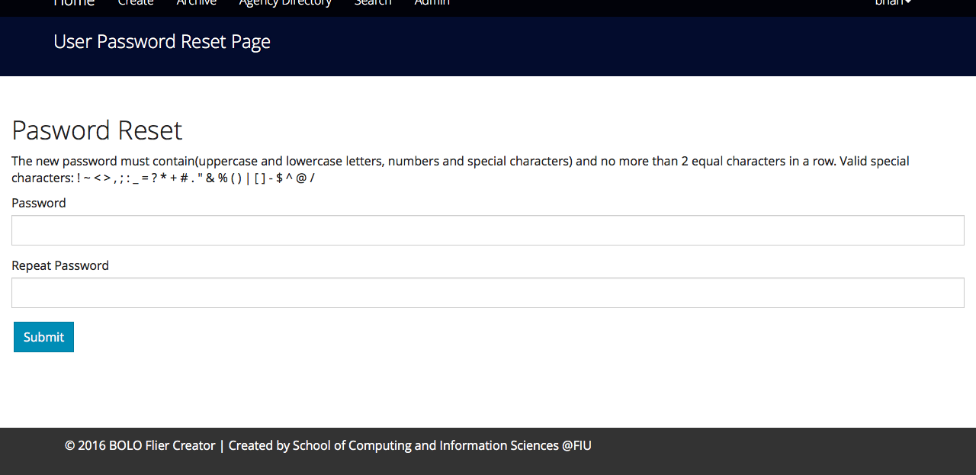
#1180 – Set Password
This added functionality assigns every new user a temporary password token which they use to login to the system. They are then prompted to change that password upon initial login.
In previous versions, the administrator or root user that was registering the user needed to assign the user a password. The user was never prompted to change that password.

Slide 13
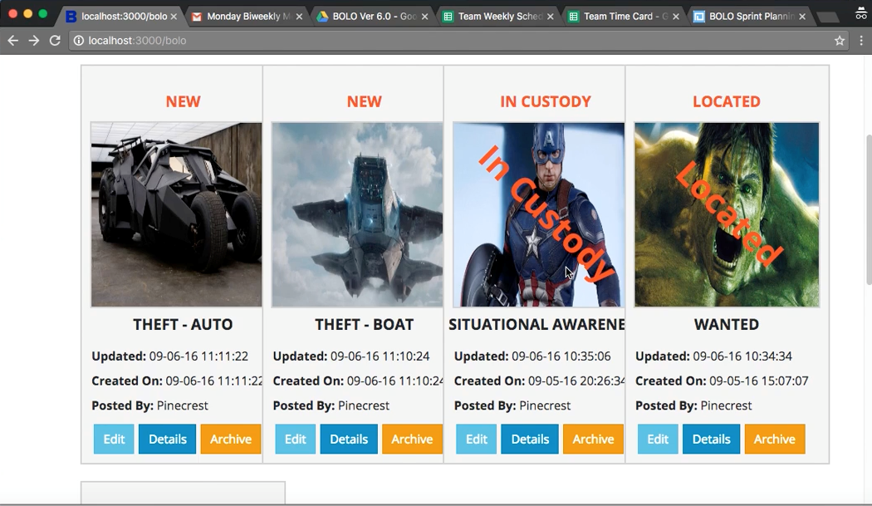
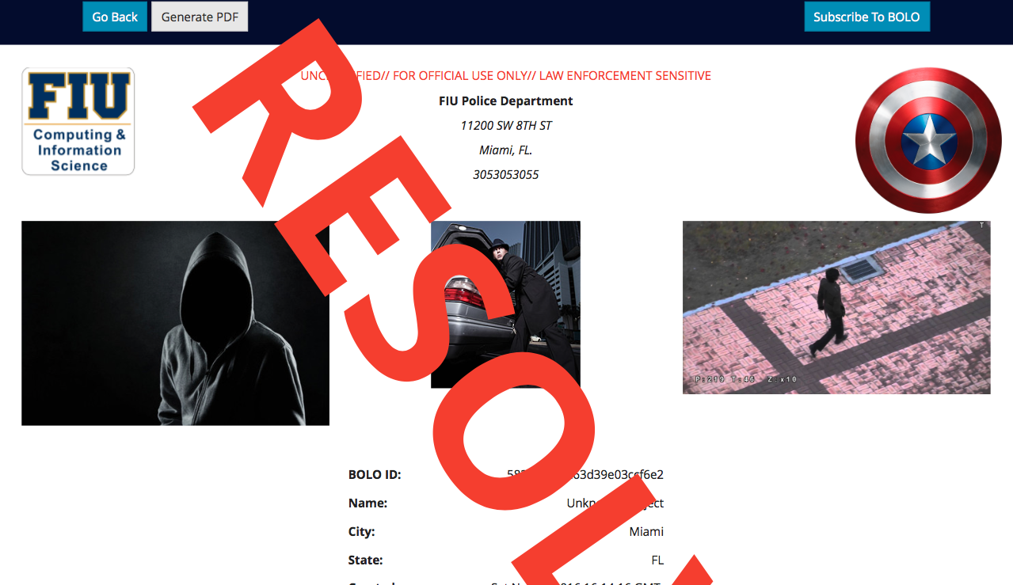
#1187 – Generate watermark on BOLOs

Slide 14
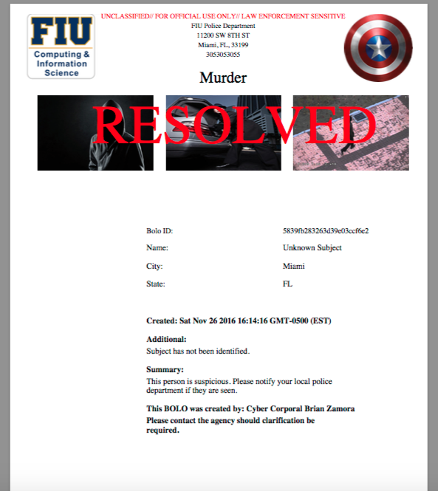
#1199 – Adjust PDF Rendering for MongoDB
This added functionality allows the PDF to be rendered more cleanly, with text being more centered and readable. Also more than one image can be rendered in the PDF. The watermark is also rendered when applicable.

Slide 15
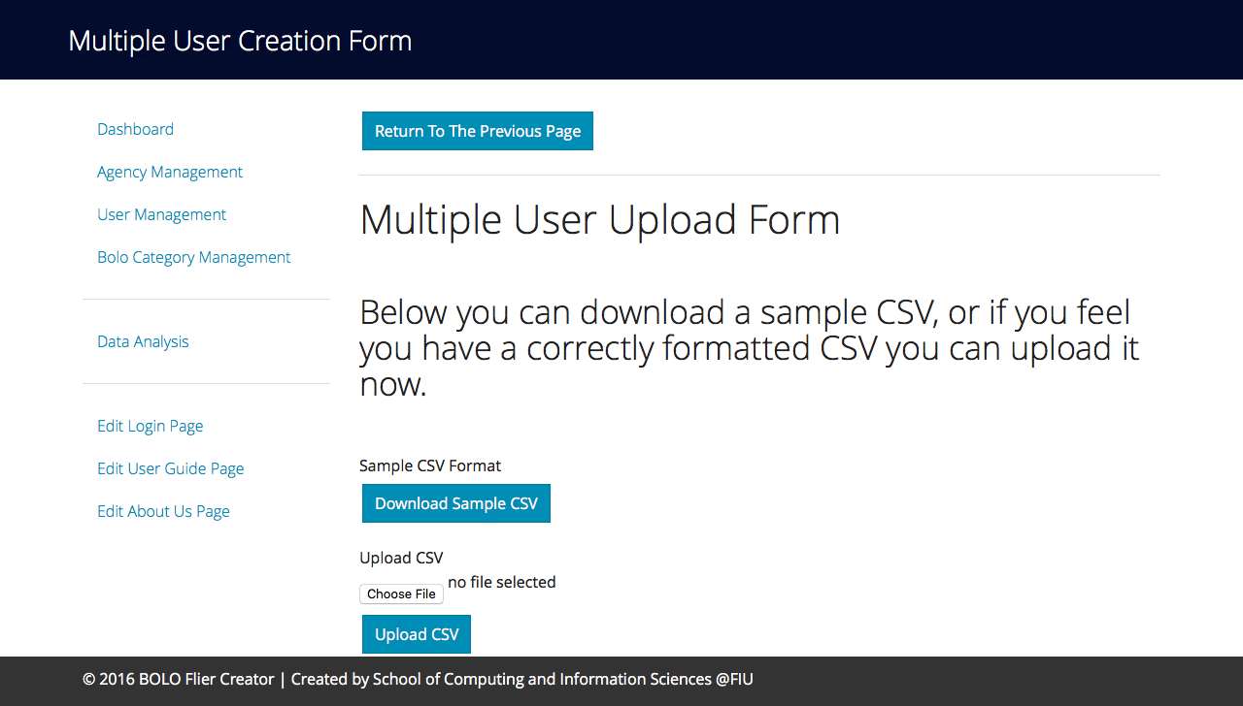
#1195 – Adjust CSV Uploading
This added functionality allows a root or administrative user to upload a csv of users so that they can register more than one user at time

Slide 16
Sample Test Cases
ID | BOLO_CreateUser_1
Purpose | Sunny-day test to create a new officer user
Precondition | A user is signed in as an administrator The node app is running The node app is connected to database The user does not exist on the database Agency Pinecrest exists on the server
Input | Username: abc123 First Name: bob Last Name: Test Agency: Pinecrest Email: abc123(@pine.gov) Role: Officer Badge No.: 1234 Section / Unit: 1234 Rank / Title: Test
Expected Output | “User abc123 has been registered!”
ID | BOLO_DeleteUser_2
Purpose | Rainy-day test to check if an existing officer on the database fails to be removed after password is entered incorrectly
Precondition | The user is signed in as a root user The node app is running The node app is connected to database The user ‘deleteMe’ exists on the database
Input | Select ‘Delete User’ on ‘deleteMe’ user details page Enter incorrect user password
Expected Output | “Password was incorrect. Please try again”
ID | BOLO_CreateCategory_1
Purpose | Rainy-day test to check if the system will not save a new category with the same name
Precondition | The user is signed in as a root user The node app is running The node app is connected to database The category Car already exists on the database
Input | Enter A Name For The New BOLO Category: Car Enter Fields {abc, qwe, asd, zxc, xyz}
Expected Output | “Category Car already exists on the database”

Slide 17







Summary
The project was done using agile development where project members had sprint meeting five days of the week. A meeting with the product owner occurs every Friday and sprints last bi-weekly.
Contact Information
Brian Zamora: bzamo007@fiu.edu - Dominick Martelly: dmart120@fiu.edu

